Slide 1

Hacking Quantum Key Distribution Hardware
or How I Learned to Stop Worrying and Burn Things with Lasers
@crazy4pi314

Slide 2


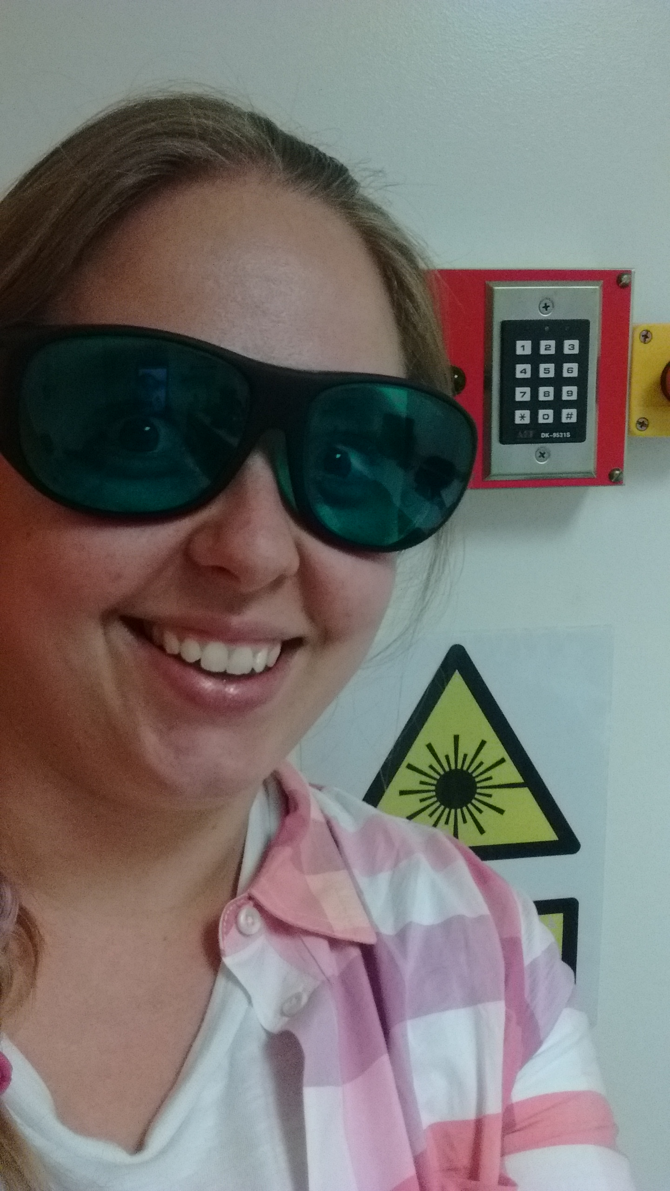

about-me.md

Slide 3
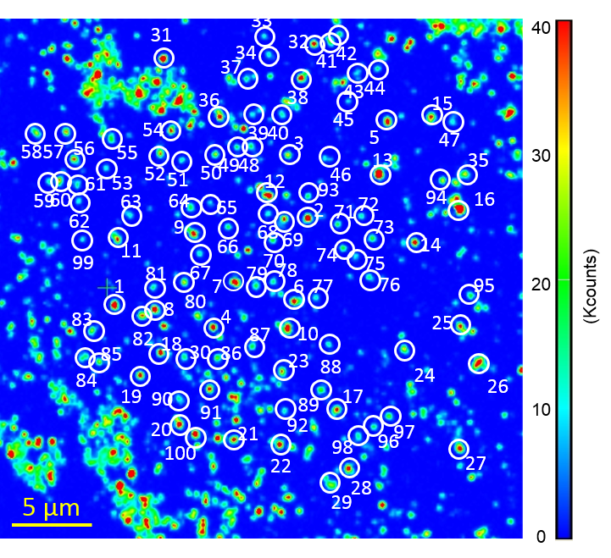
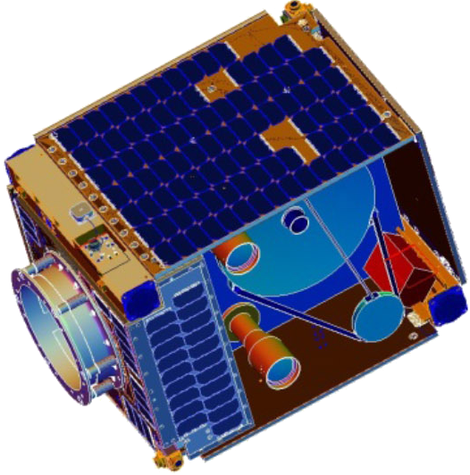
Quantum Technology
Photo Credit: Microsoft
#bitcoin #buzzwords #FOMO #Blessed

Slide 4
What can quantum tech do for information security?
☹ Factoring large numbers
☺ Securely exchanging cryptographic keys
Notes:
Talk about PQCrypto, but beyond scope

Slide 5
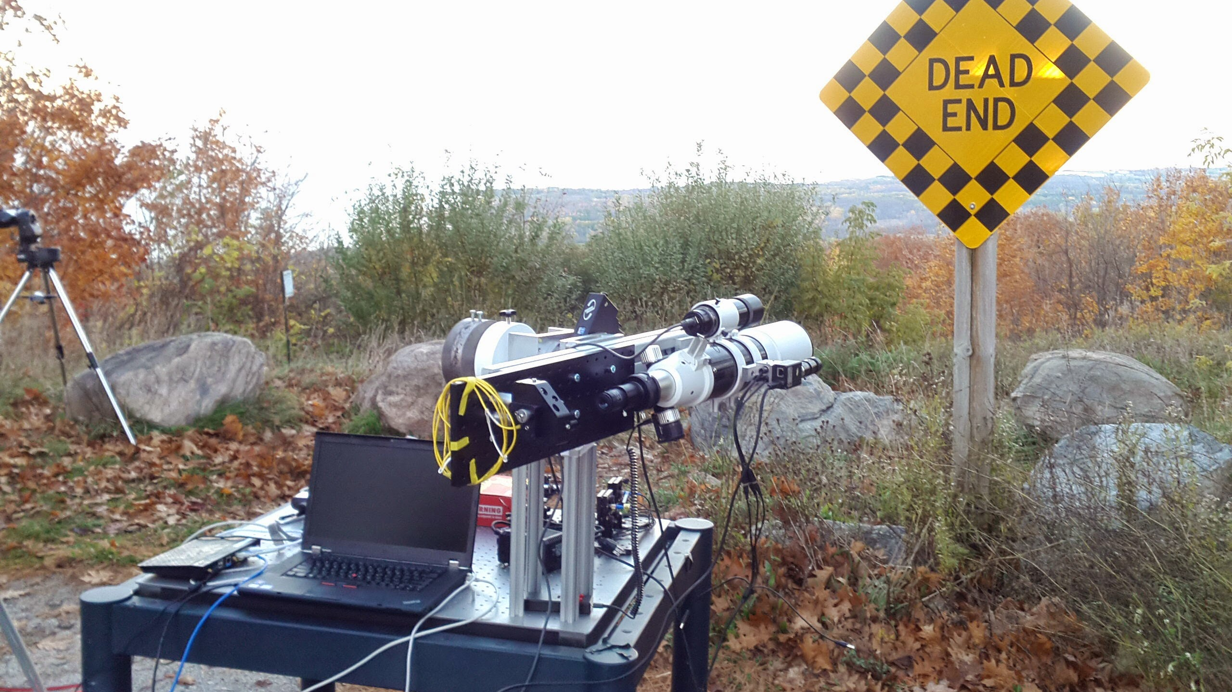
Exchanging quantum keys

Slide 6
Quantum Key Distribution (QKD)
Objective: share a secret key between Alice and Bob
Quantum
Alice
Bob
photons
Classical
PROVABLE SECURITY!
Good reviews: doi.org/10/bjxpf6, doi.org/10/dshjwp , and bit.ly/qsharp-book
Notes:
Talk about book link

Slide 7

QKD protocol : BB84
Alice
Bob
Alice sends
Bob measures
Matches?
Notes:
No cloning, tamper proof seal

Slide 8
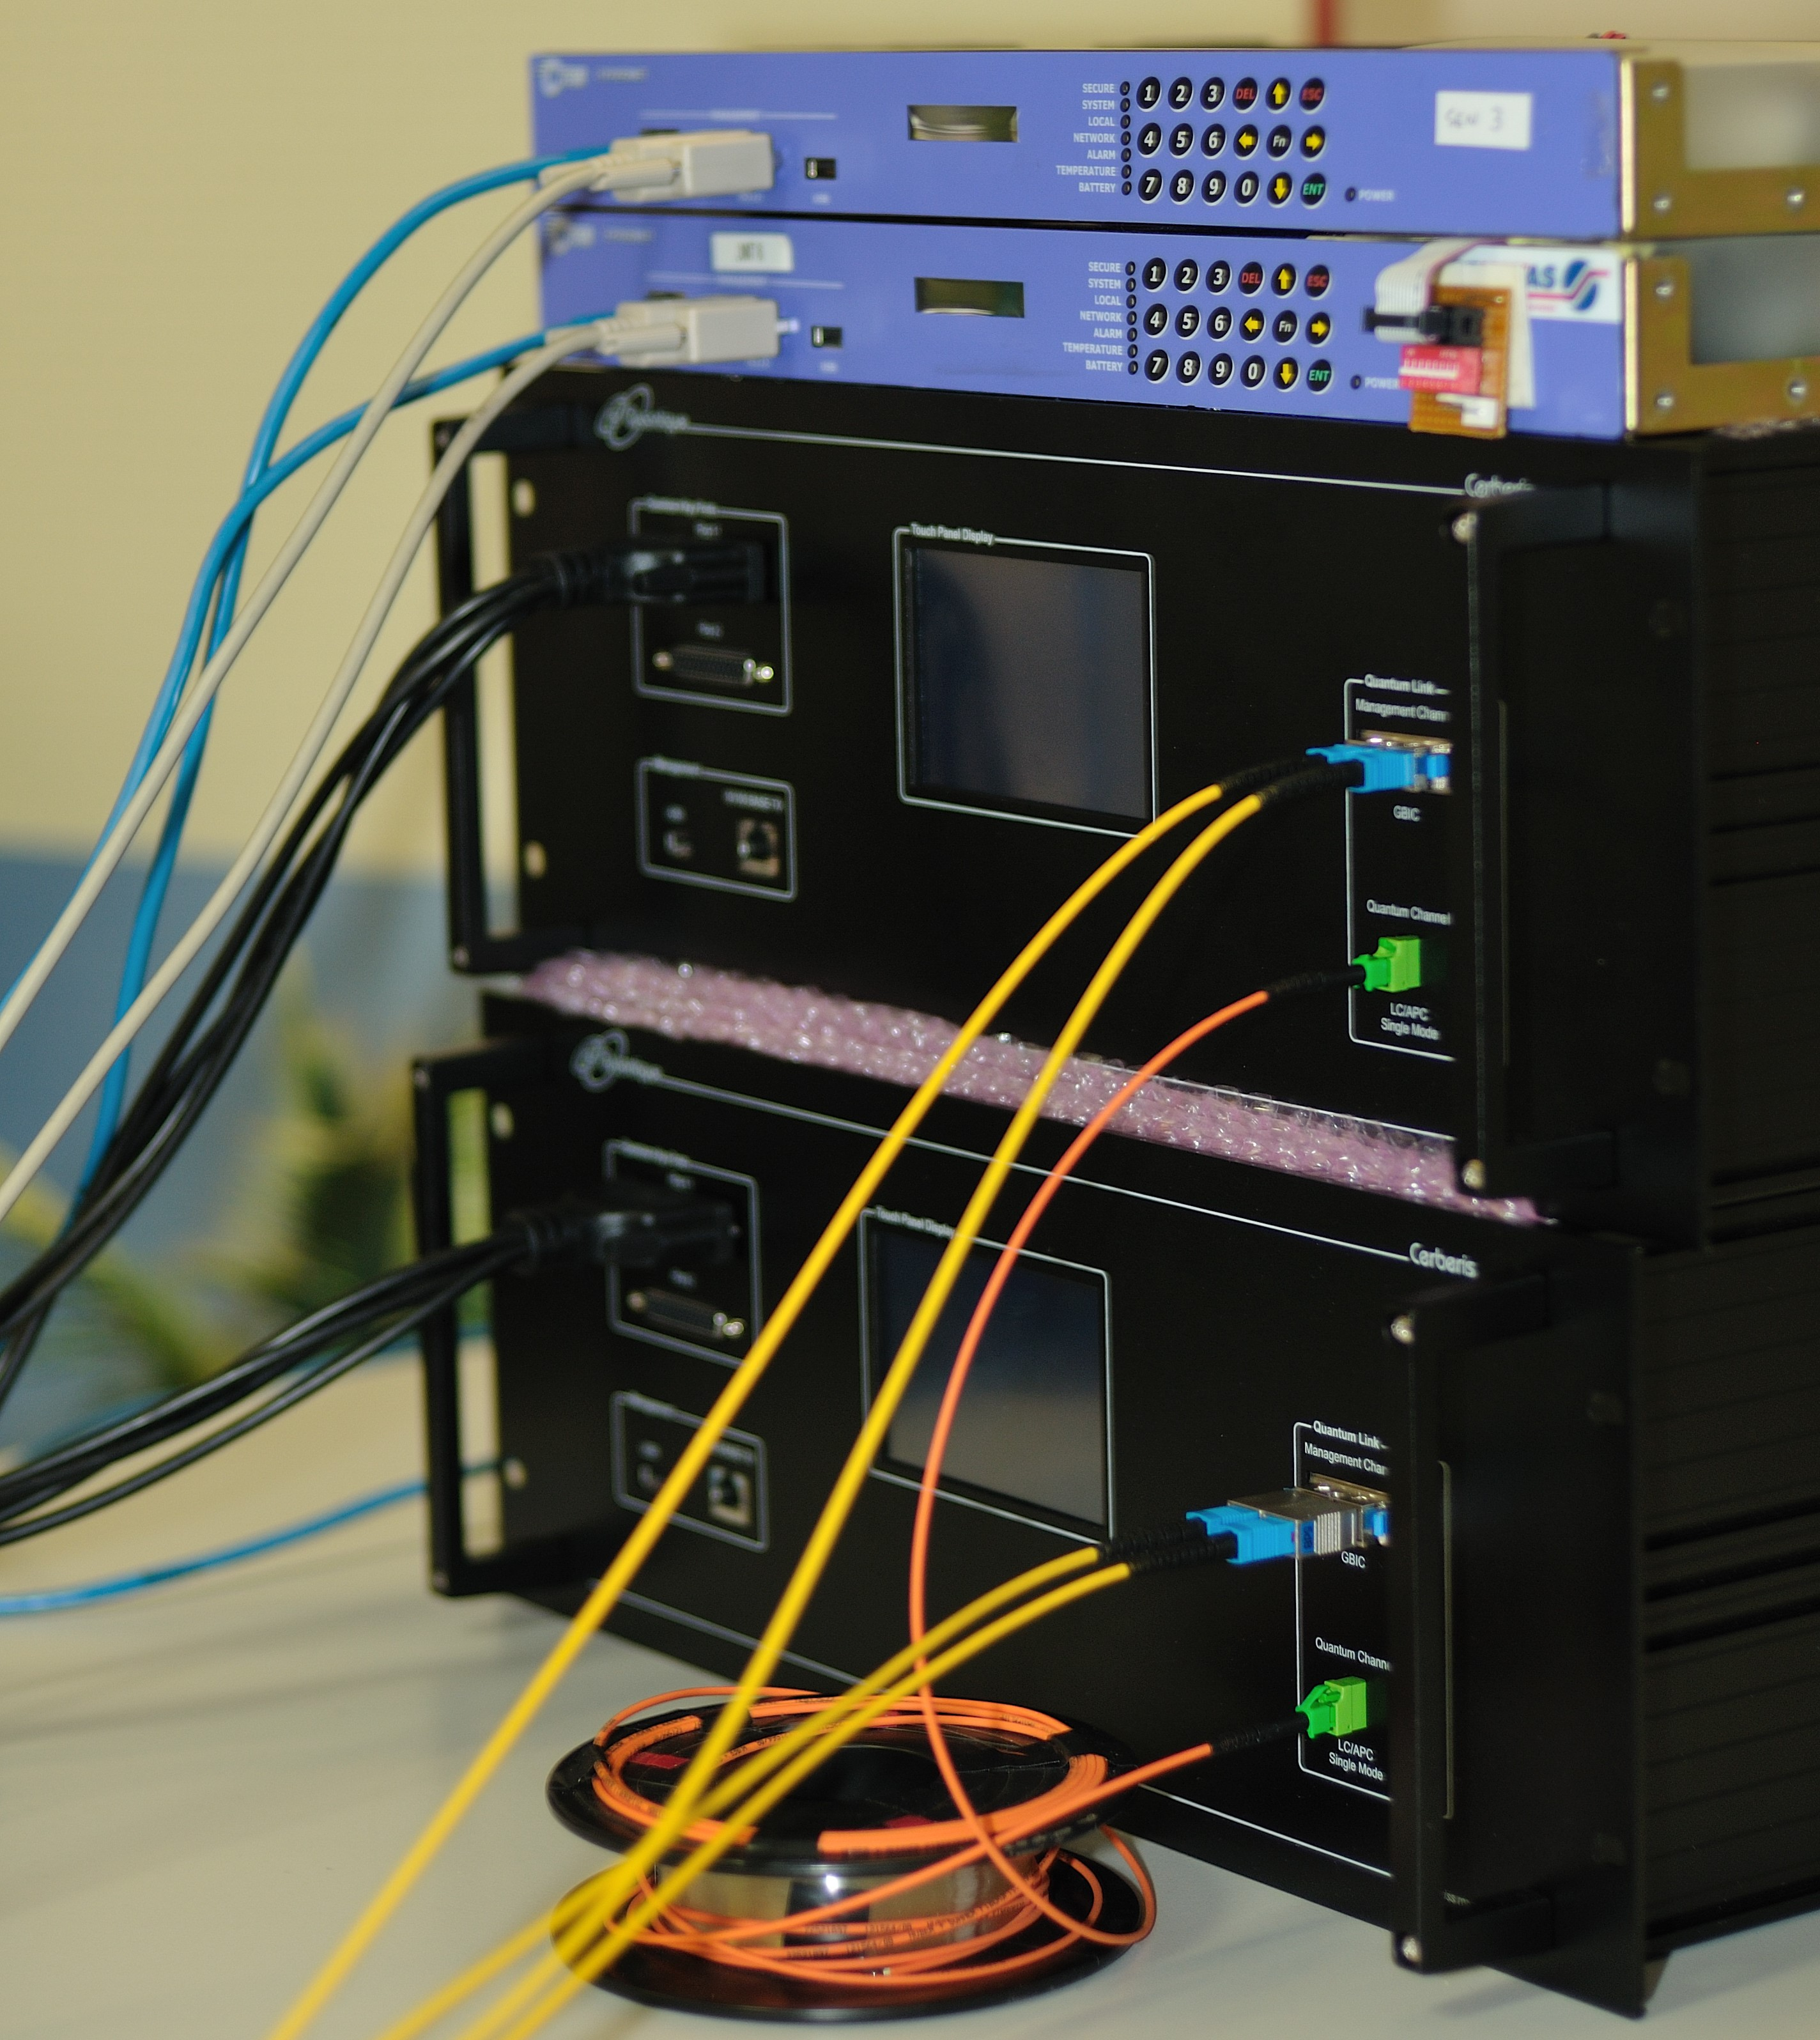
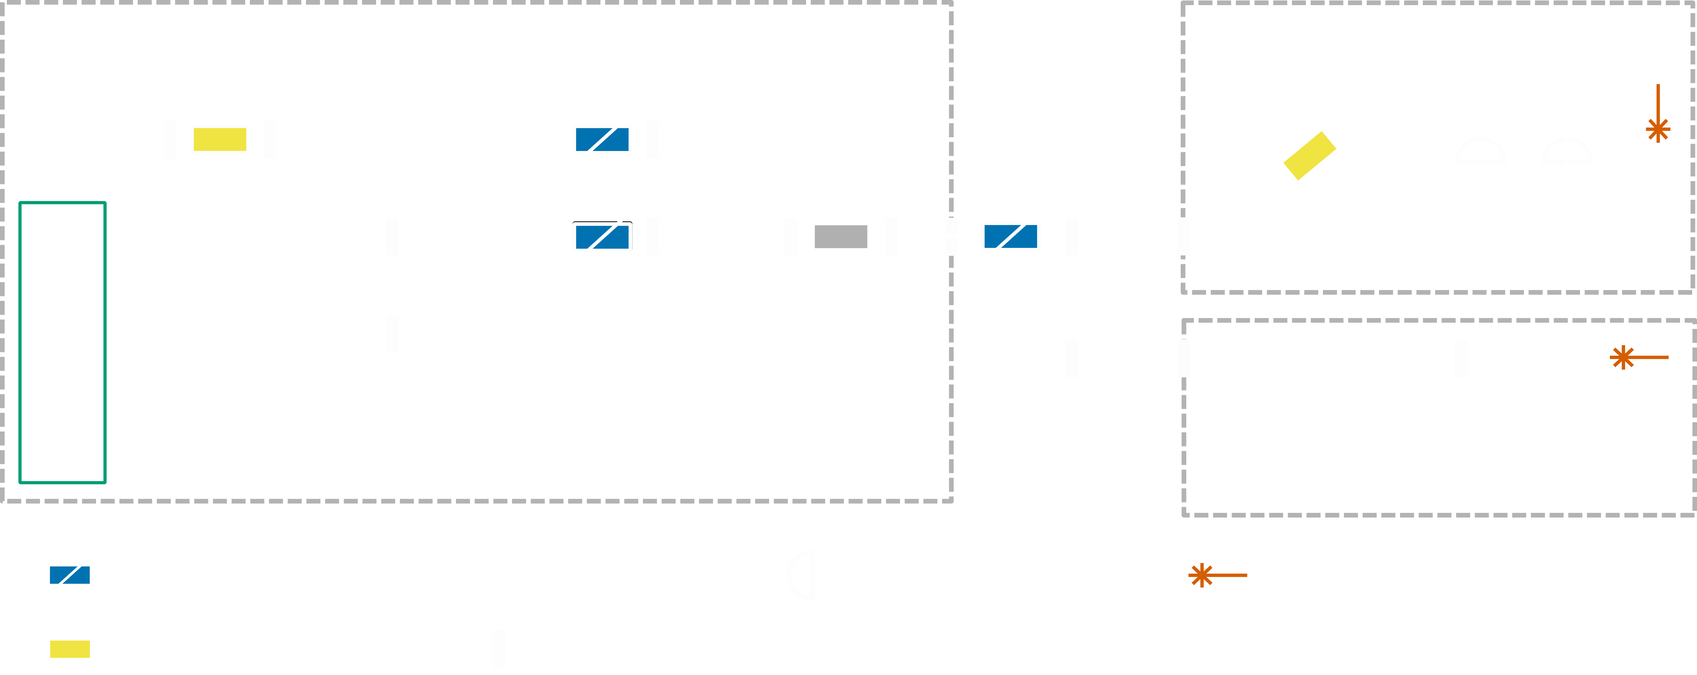
The ID Quantique QKD system

Slide 9
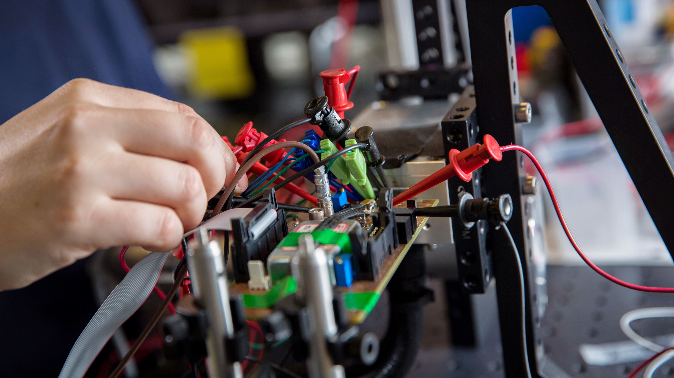
Quantum hacking

Slide 10

Provable security for QKD is…
https://imgur.com/gallery/QPz1hjm

Slide 11
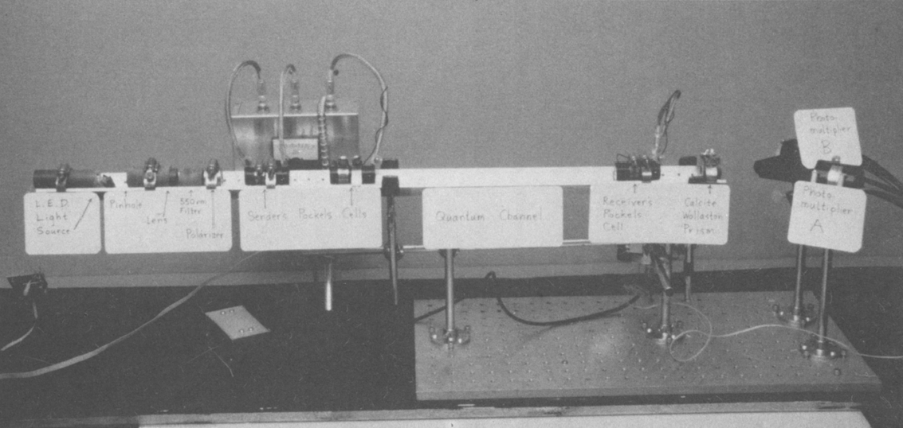
The IBM QKD proof of concept device (~1992)

Slide 12
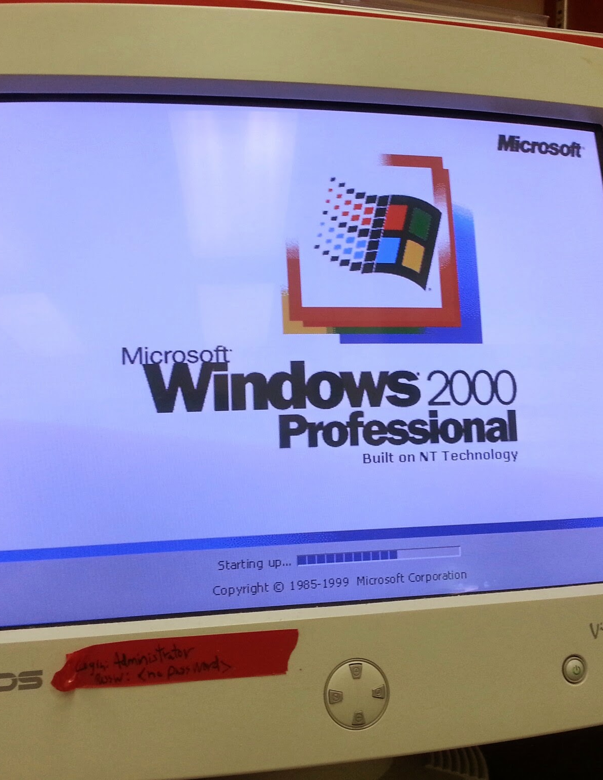
Ways to break hardware assumptions
Known quantum attacks:
Timing doi:10/c97d7r
Detector control doi:10/d6cgxf
Multi-wavelength doi:10/fnqkhz
Notes:
Talk about the counter measures implemented
You don’t want to loose the advantages you got with the quantum in the first place!

Slide 13
The ID Quantique QKD system

Slide 14

GET THE LASERS!!!
http://thirdmonk.net/high-culture/leslie-nielsen-gifs.html

Slide 15
Recipe for “disabling” the monitoring diodes
Test each optical fiber component to see how much power they can really handle
Characterize the behavior of the monitoring diodes
Determine ideal attack conditions
Profit! (try a full attack)

Slide 16
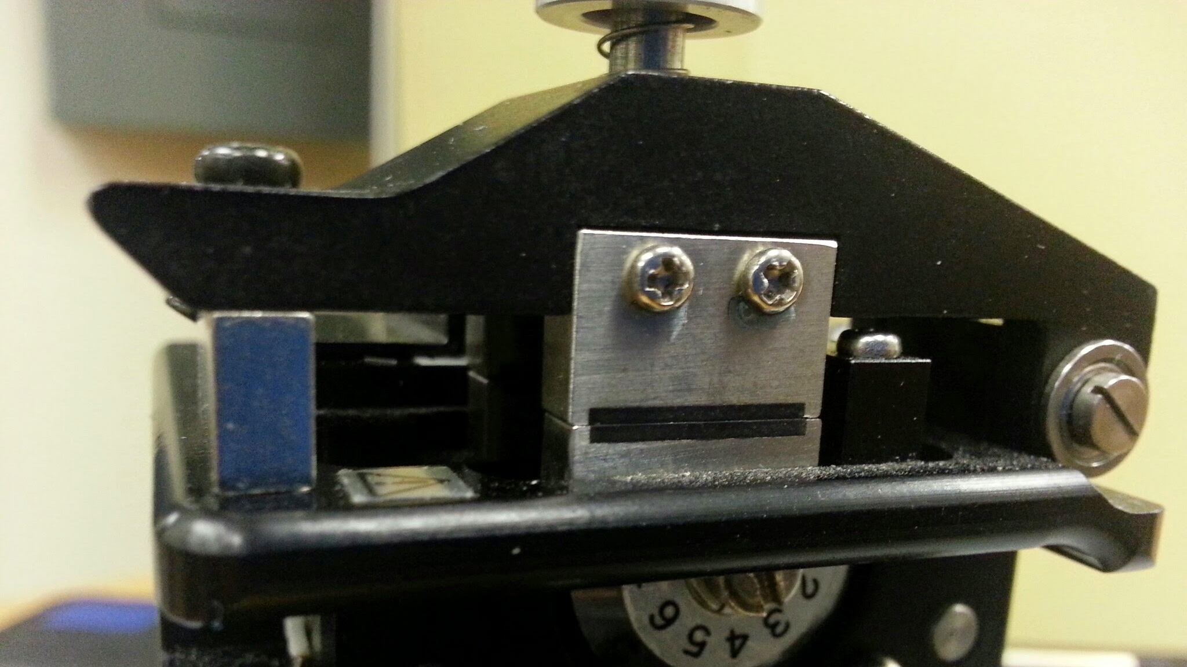
FIRE THE LASERS
Experiment results

Slide 17
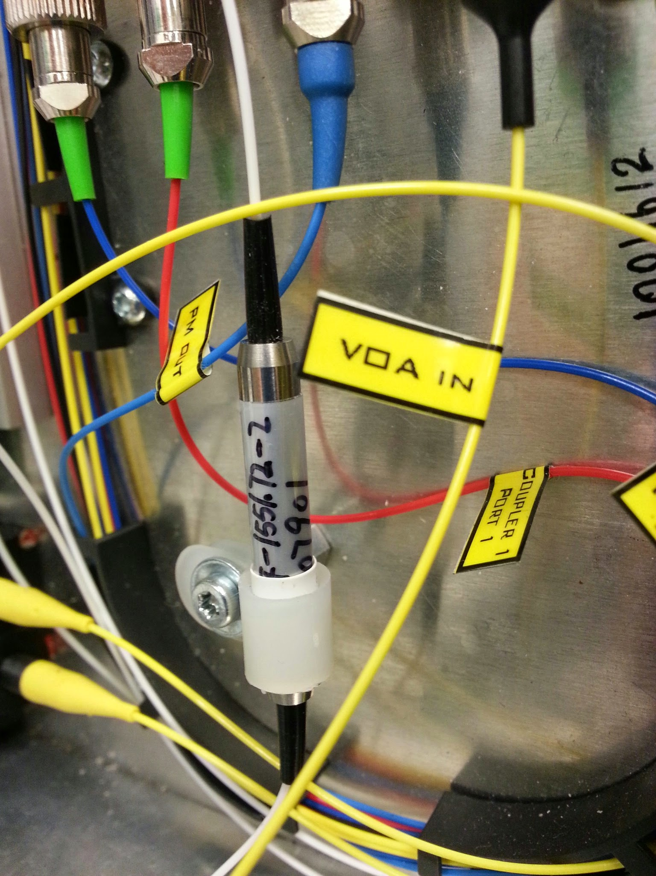
Step 1. Test each optical fiber component
How much power can they handle?
Fiber + Splices
Connectors
Splitters
Attenuators
Answer: All we could throw at them! (~15 W CW)

Slide 18

Sooooo much laser power….

Slide 19
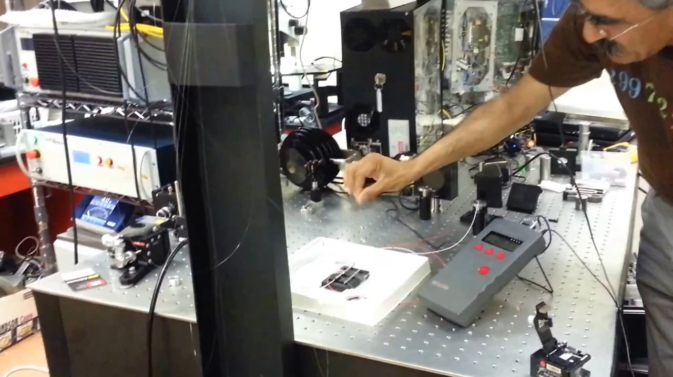

Slide 20
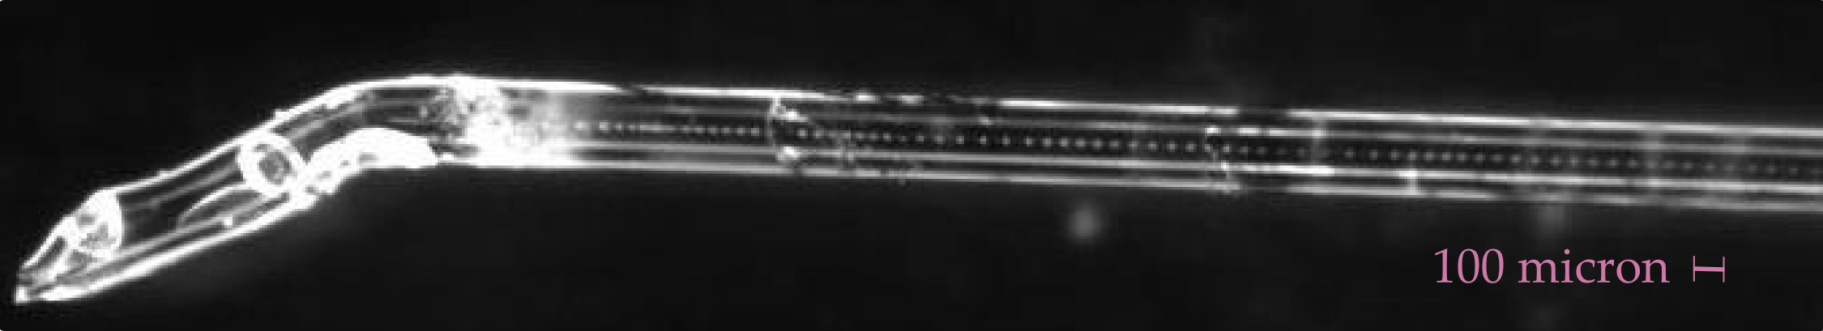
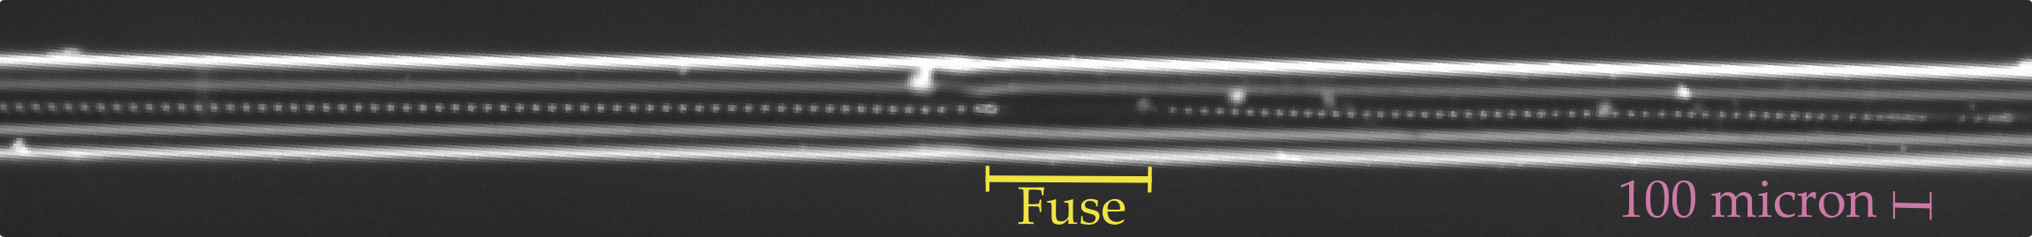
Side quest: Fiber Fusing
@crazy4pi314

Slide 21
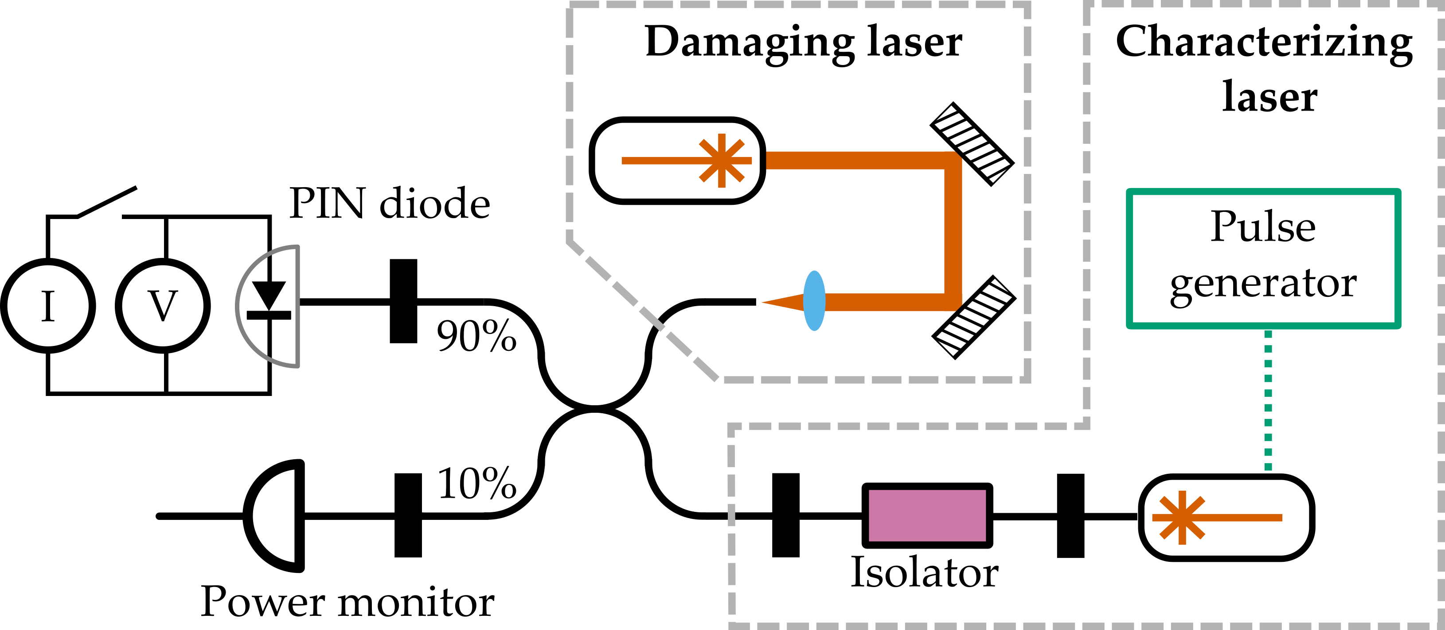
Step 2. Testing the monitoring diodes

Slide 22
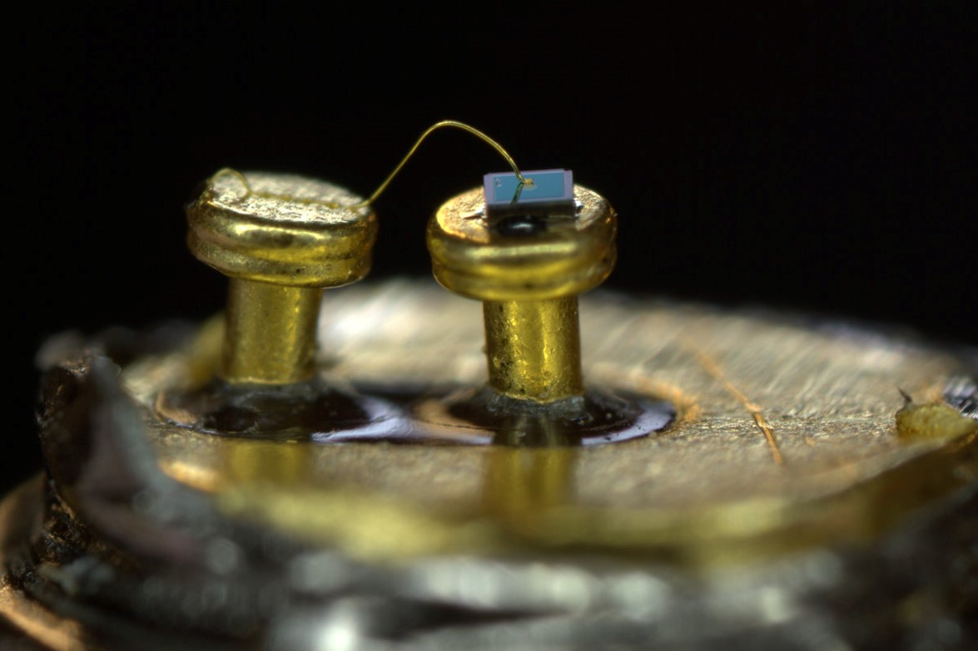
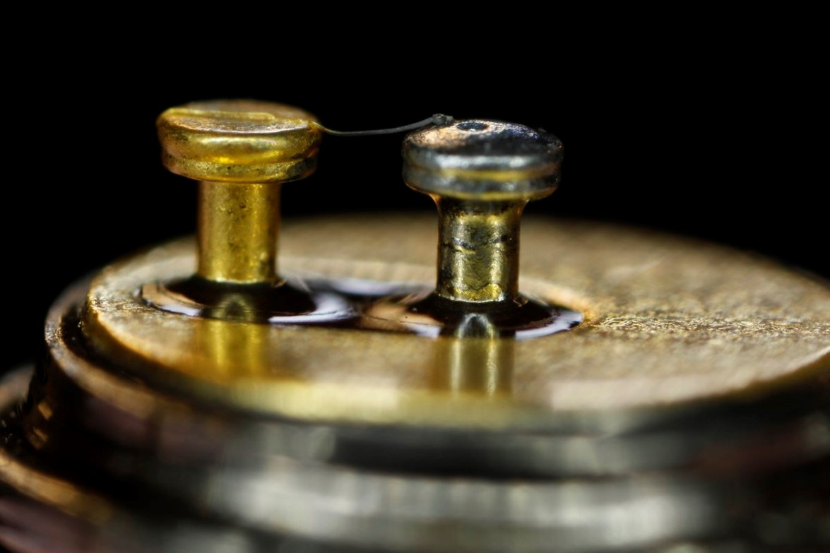
Investigating monitoring photodiode damage
New Detector
Post-attack detector

Slide 23
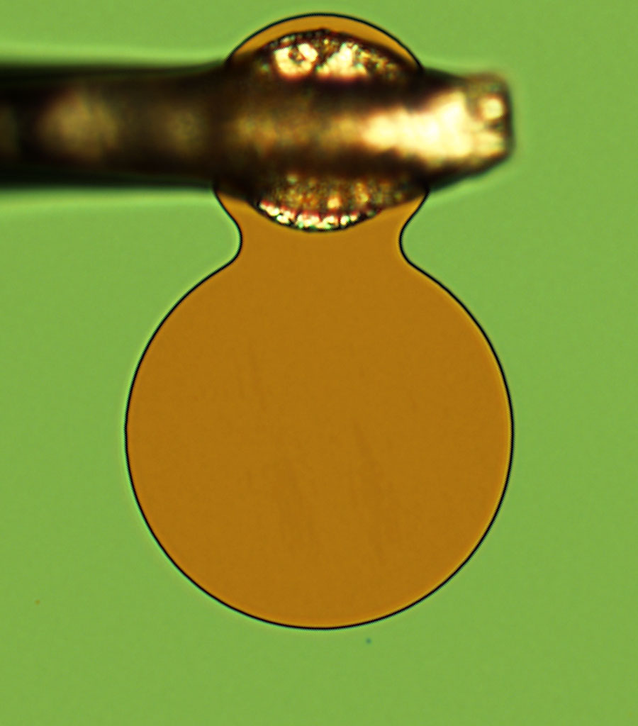
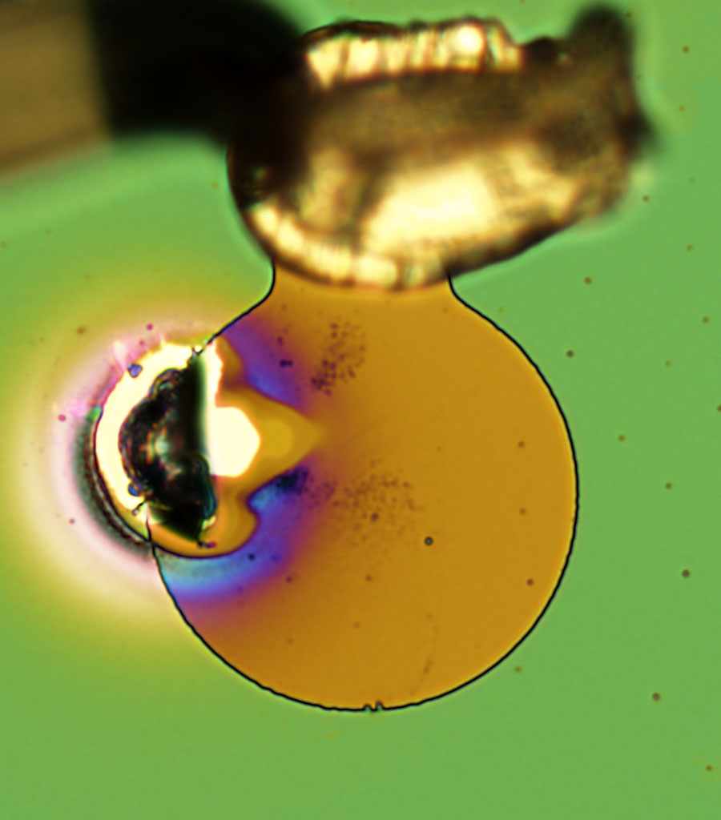
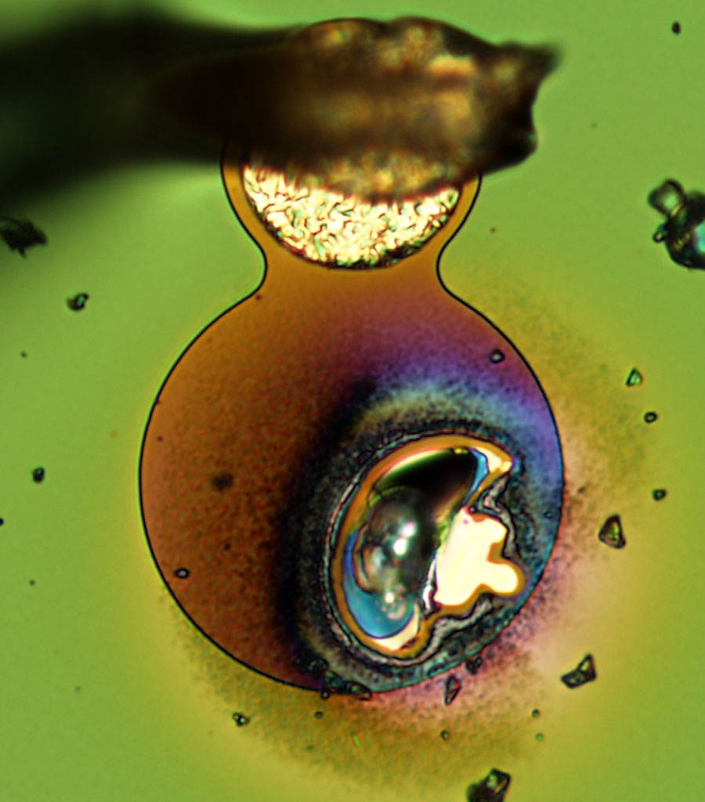
SEM images of the photodiode
That will work!

Slide 24
Step 3. Attack paths found
Full key: Melt detector and it fails not in alarm mode (small but finite chance)
Partial key: Decrease detector efficiency by 20-40%, which enables other attacks

Slide 25
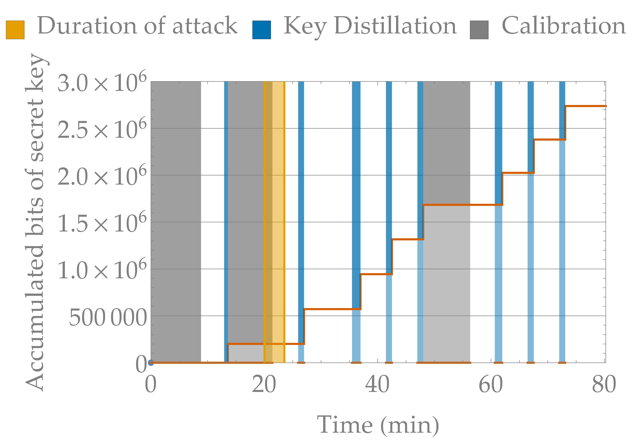
Step 4. Attack demo!
Full key attack on
running system

Slide 26
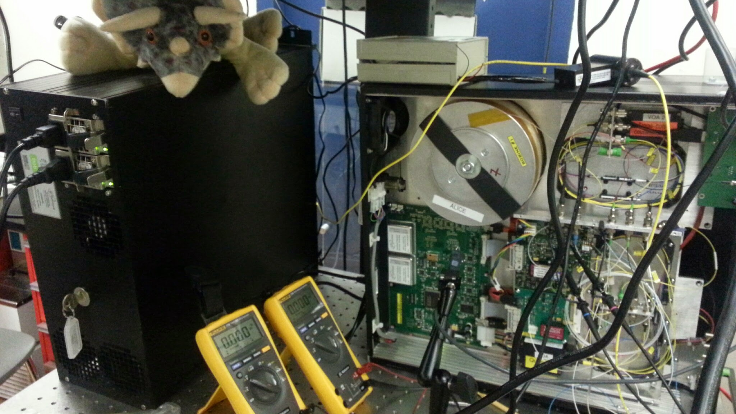
Lessons learned
Don’t look in laser with remaining eye

Slide 27
I Learned to Stop Worrying and Burn Things with Lasers ♥
Brute force sometimes is the best force
Physical side channels can compromise even the best security
Quantum hardware and software needs existing expertise!
Want to learn more about quantum tech or QKD? Find me on twitter @crazy4pi314

Slide 29
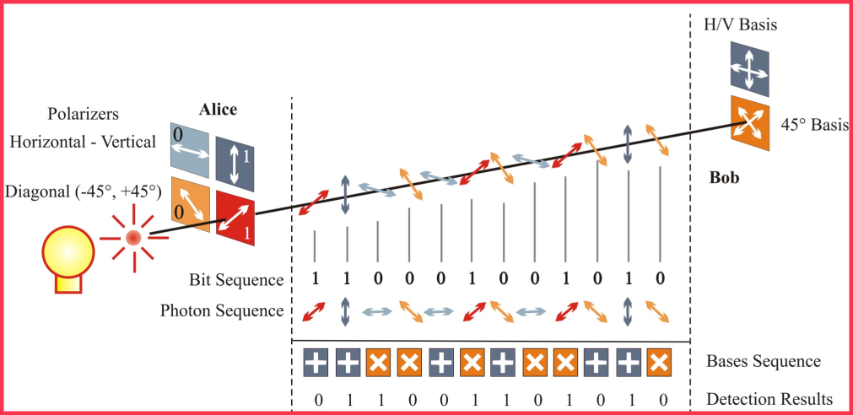
BB84 protocol: quantum phase

Slide 30
QKD protocol : BB84
Alice
Bob
0
1
0
1
0
1
1
0
1
0
1

